Slide 1


IOD – Mini Project 1
Sebastian Giunta 2022

Slide 2
Agenda
Data Overview
Objective
Dataset
Pipeline
Data Story
Analysis Focus
Conclusion

Slide 3
Data Overview

Slide 4


Objective
Analysis of reported crime incidents in Sydney LGA between Jan 2013 and Mar 2016.
Purpose is to explore this data and achieve a greater understanding.
Source: https://data.nsw.gov.au/data/dataset/non-domestic-assaults-sydney-lga

Slide 5
Dataset
Each record is an offence that has been reported in the NSW Police Force Computerise Operational Policing System (COPS)
Incidents occurred at an outdoor or public place (parks, streets, footpaths) within the Sydney Local Government
23605 Observations
Data Columns
Offence Type
Sub Offence Type
Suburb
Incident Date
Sex
Age

Slide 6
Pipeline
Data Cleaning
Remove Columns
Create Age Bins
Ignore records with no Age reported
Exploration
Understand Numerical Columns
Develop Focus Questions
Visualisation and Analysis
Conduct Visualisation to assist answering questions

Slide 7
The Data Story

Slide 8
Analysis Focus
What is the most common type of crime?
How do offences change based on day of week?
Which age group and sex commit the greatest number of crimes?
Which is the most common suburb for crime to take place?
What is the most common time for crime to take place?
What is the overall trend in number of crimes in this period? Explore Assaults & Drug Offences, as well as conduct hypothesis test.
What does the heatmap of offences look like?

Slide 9
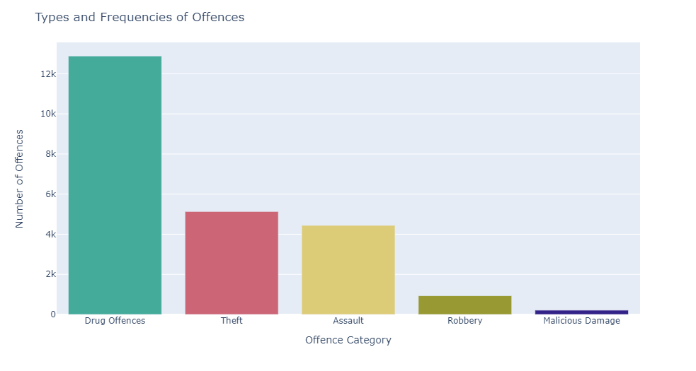
55% of offences committed are Drug Offences

Slide 10
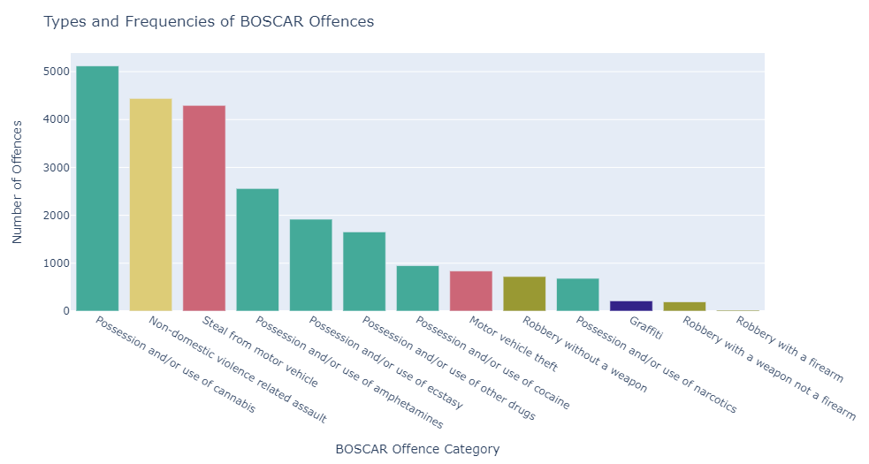
Cannabis, Assault & Stealing from Cars are the most common sub offences

Slide 11
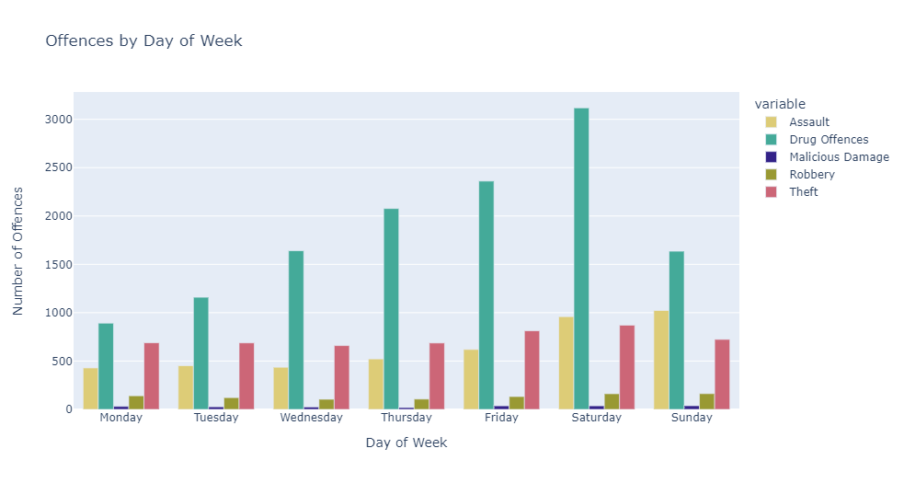
Drug Offences spike on Saturdays

Slide 12
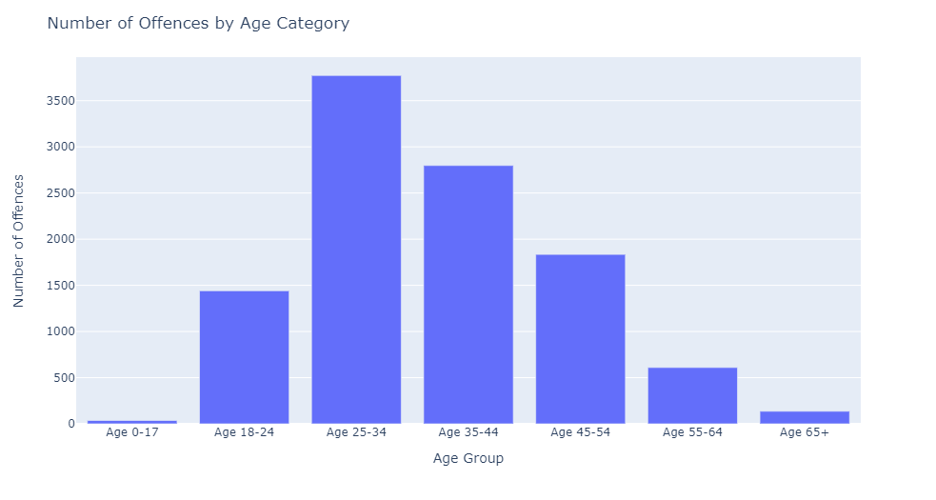
25 to 34 years are the most likely to commit an offence

Slide 13
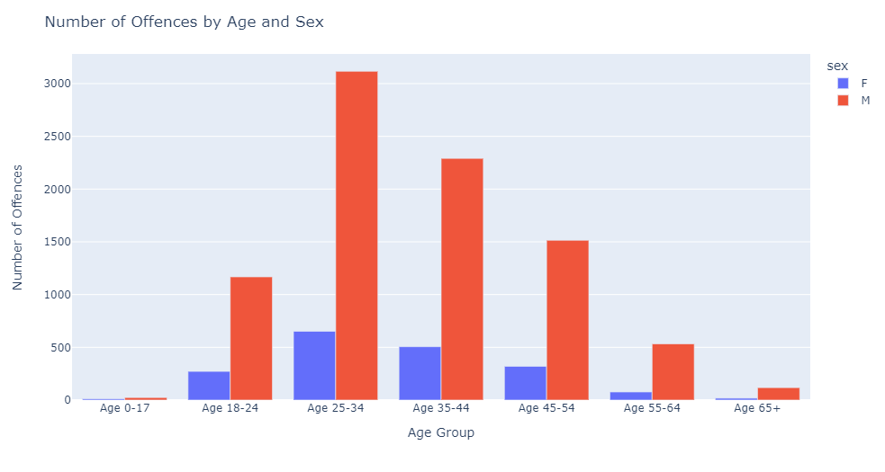
Males commit on average 5-6x more offences than Females

Slide 14
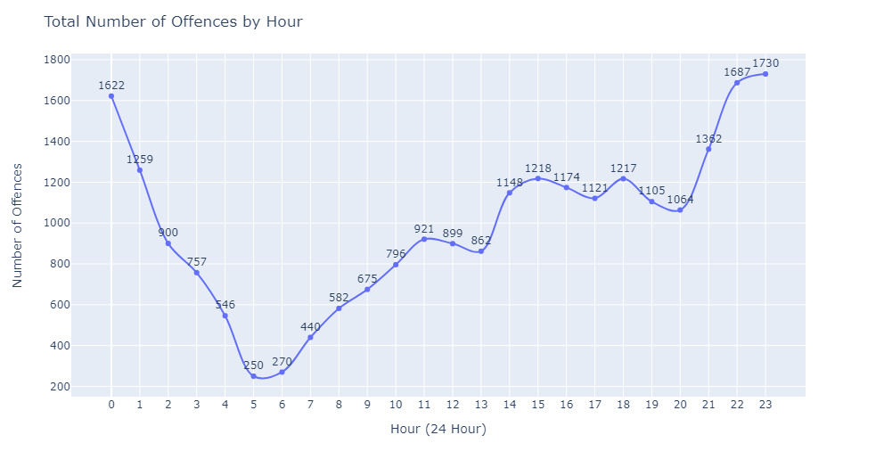
Offences are most likely to be committed between 10pm – 1am

Slide 15
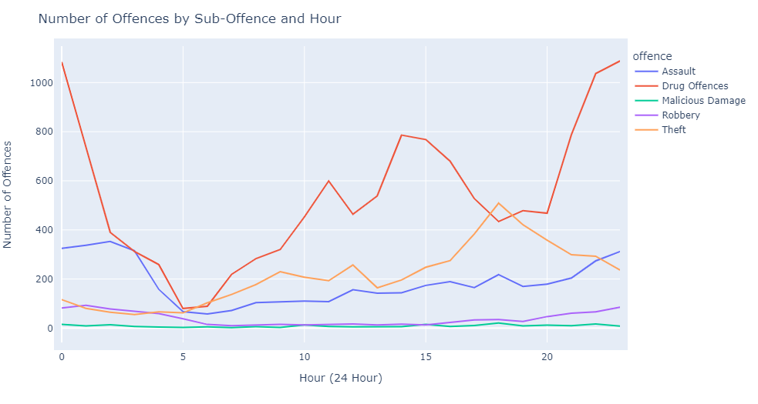
Assaults are most common between 11pm-3am

Slide 16
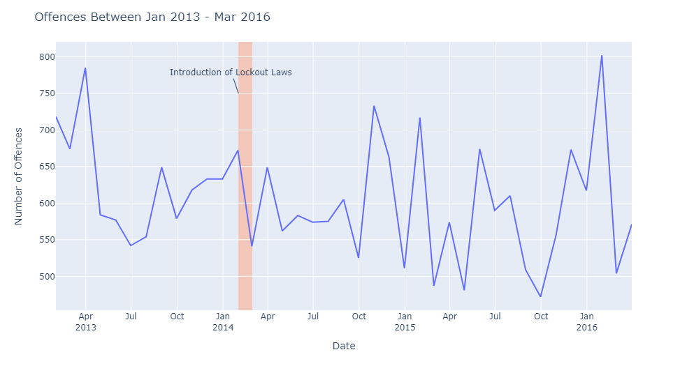
Offences can vary greatly month to month

Slide 17
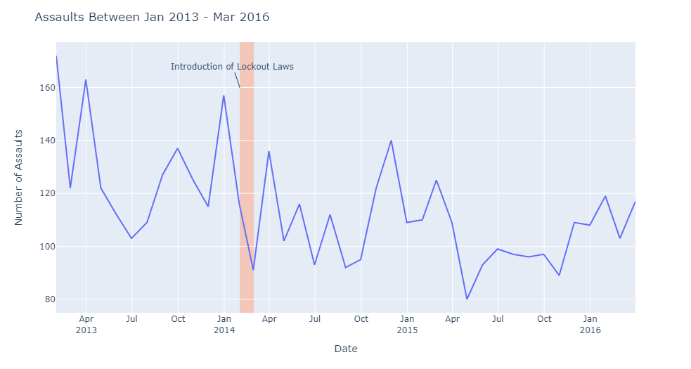
Introduction of the lockout laws appears to have decreased overall number of assaults

Slide 18
Hypothesis Test Null: The lockout laws had no impact on the number of assaults committed Alternative: The lockout laws did have an impact on the number of assaults committed
 | Pre Lockout Laws (Mean) | Post Lockout Laws (Mean) | P-Value
T-test | 129 | 111 | 0.024

Slide 19
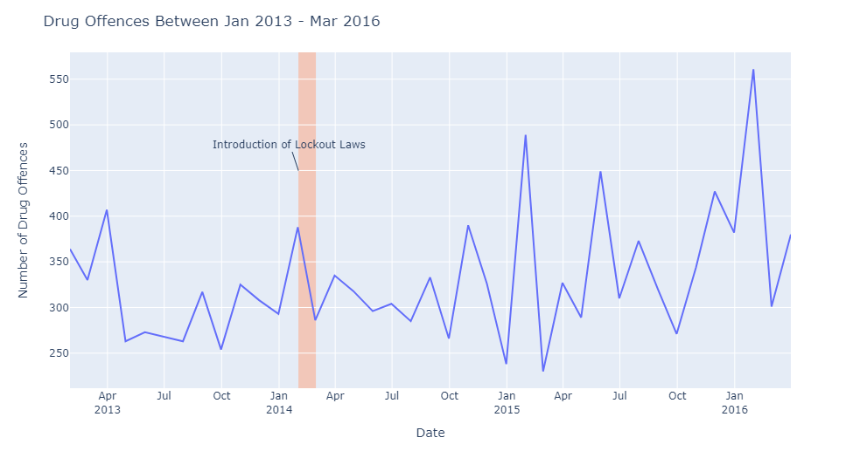
Drug offences appear to have increased after the introduction of the lockout laws

Slide 20
Hypothesis Test Null: The lockout laws had no impact on the number of drug offences committed Alternative: The lockout laws did have an impact on the number of drug offences committed
 | Pre Lockout Laws (Mean) | Post Lockout Laws (Mean) | P-Value
T-test | 312 | 315 | 0.888

Slide 21
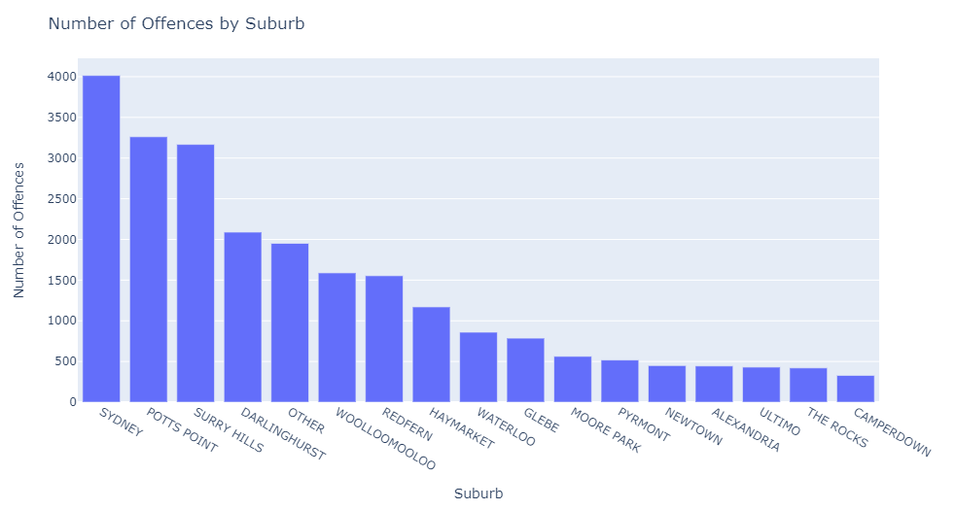
Sydney CBD and Inner Suburbs have the highest number of offences

Slide 22
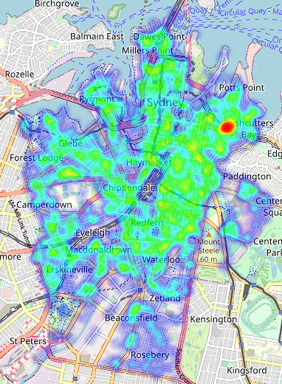
Kings Cross has a much larger density of offences, compared to surrounding areas

Slide 23
Conclusion

Slide 24
Key Insights
Males aged 25-34 are the most likely to commit a crime in public places in the Sydney LGA
Most crimes are committed between 8pm-3am
The lockout laws had an impact on reducing the number of assaults in this area
Total number of offences trend is relatively flat, further research would be required to better understand how to reduce this trend.

